Slide 1
Golden Rules of OPAMP
OPERATIONAL APLIFIER
Presenter:
Supervisor:
Mehrin Farzana
ID. 2101013
Dept. of IRE
BDU
2021-22
Sadiya Enam
Lecturer(EEE)
Dept. of IRE
BDU

Slide 2
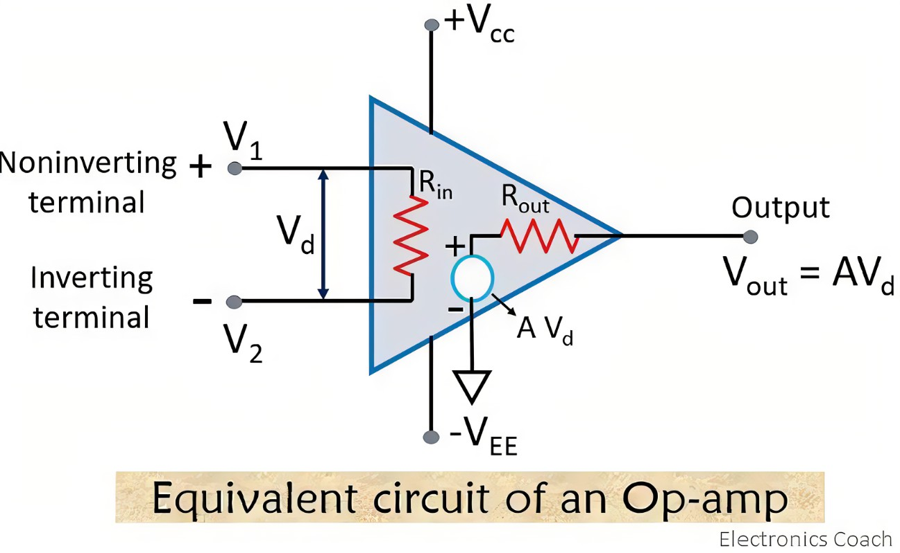
01
Golden rules of OPAMP (operational amplifier)
The inputs draw no current
Positive input voltage = Negative input voltage
V_{p}= V_{n}
Figure 1: OPAMP

Slide 3

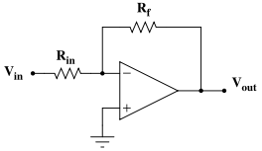
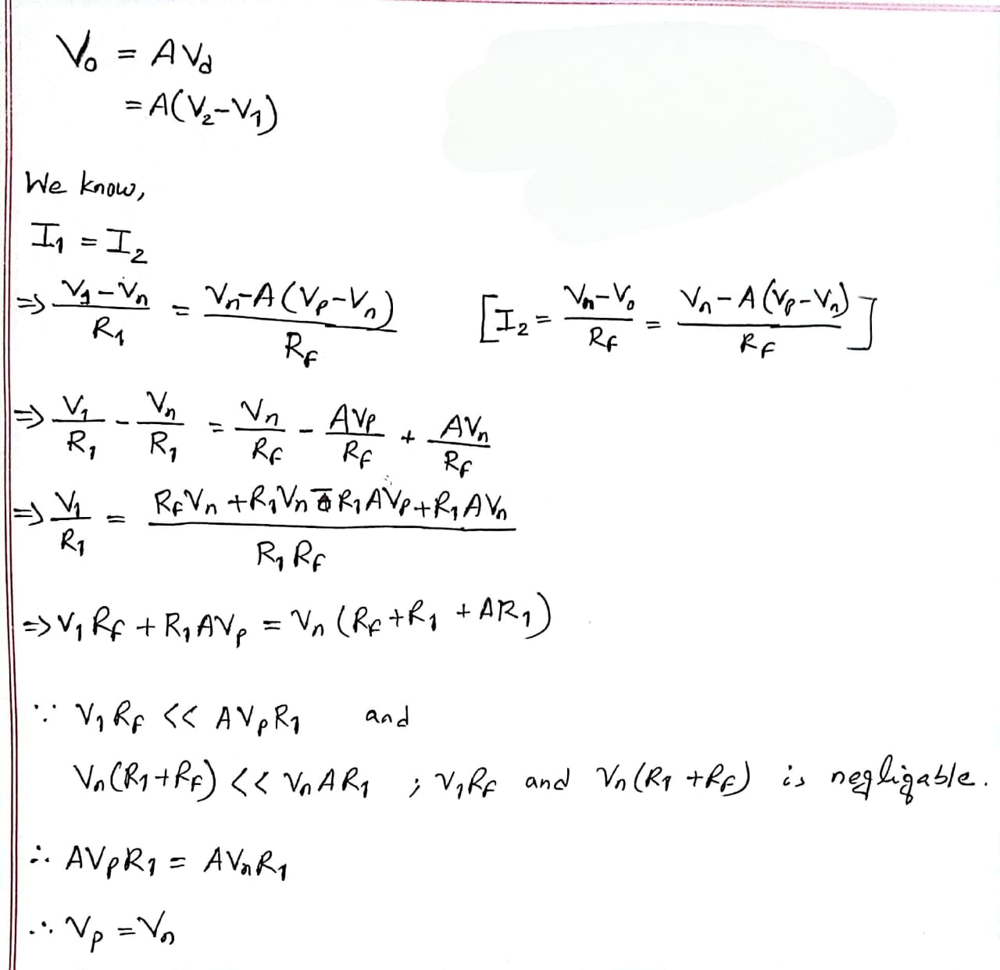
02
Proof of Vp= Vn
R_{F}
With negative feedback,
Here,
Output voltage = V₀
Input voltage difference = V_{d}
Feedback resistance = R_{F}
R₁
V₁
V_{n}
V_{p}
V₀
Figure 2: OPAMP with negative feedback
[Proved]

